Slide 1







Process of Opportunity Identification
own / others
problems
needs
EVALUATION
MARKET
CREATIVITY
BUSINESS IDEA
RESOURCES
ACTION!
skills and knowledge
creativity
financial
social

Slide 2


WHAT YOU NEED TO DO Use Your Resources
Remember: resources are more than money!
Focus on your strengths.
Focus on your interests.
Don't forget your social networks they can bring resources too!
Look for new resources, don't wait for them to appear!

Slide 3
Matthew 25: 14-30
The Parable of the Talents teaches that God always gives us everything we need to do what he has called us to do.

Slide 4


WS
12
EXERCISE: Your Strengths, Your
Interests & Other Resources
Instruction:
Think about your
Strengths - List 5 which you are good at
Interests - List 5 you really like doing
Other resources - List 5 (e.g. your social or financial resources)
Now try to create 2 business ideas that include (at least) one of your strengths, one of your interests and one of your other resources. Present your ideas to your partner.
What more could you do (based on your resources) to be unique?
EXAMPLE
Notes:
Refer back to „combination/creativity“ exercise (combine balla nd bicycle)

Slide 5
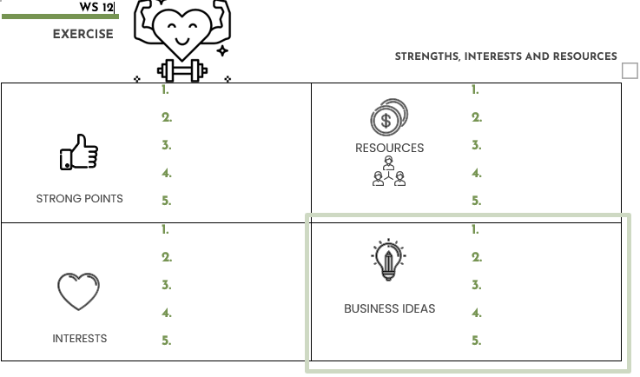
WS
12
EXERCISE: Your Strengths, Your
Interests & Other Resources
Instruction:
Think about...
5 notable strengths (which you are good at),
5 interests (what you like to do), and
5 other resources (e.g. your social or financial resources)
Now try to create 2 business ideas that include (at least) one of your strengths, one of your interests and one of your other resources. Present your ideas to your partner.
What more could you do (based on your resources) to be unique?
Notes:
Refer back to „combination/creativity“ exercise (combine balla nd bicycle)

Slide 6
EXAMPLE: Your Strengths, Your
Interests & Other Resources
Example:
Julienne is fluent in French. She likes to teach French language skills. In her home, she has a room that could be used as an office.
Strength: Being able to speak French fluently Interest: Teaching others Other resource: A free room
The business idea: Open a small language school offering French courses
What else could she do to be unique: Organise a poetry competition in French

Slide 7
WS
13
EXERCISE: Your strengths, your
interests and other resources
?
HOMEWORK:
Ask one of your friends what they think your strengths are. Write them down and compare them with the ones you generated in the exercise
What do you notice?

Slide 8
WHAT YOU NEED TO DO Identify Sources of Information
Self-Starting
Actively seek information. Don't wait to be given it.
Use different sources of information, not just one.
Look for information that is rare and hard to come by. This information has the power to innovate.
Future-Oriented
Ask yourself: What sources of information will help me learn about future problems and opportunities?
Overcoming Barriers
Identify at least one alternative to each information source you use!
Keep looking for information even if it is hard to find.

Slide 9








WS
14
EXERCISE :
Identifying Sources of Information
Instruction:
Work in groups of four (04) people. Make a list of the sources of information you can use to create innovative ideas. Can you find more than ten sources of information? Can you find sources of information that the other groups cannot find? Write down all your ideas.
Examples of information sources:
Websites
Newspapers
Look at your list of information sources. What are the useful sources of information? How can you use them to get innovative ideas for your business?
Example :
Mobile phone accessories retailer
Research websites to see how similar products are marketed in different Countries
Notes:
Depending on target groups/point in time: Add AI

Slide 10
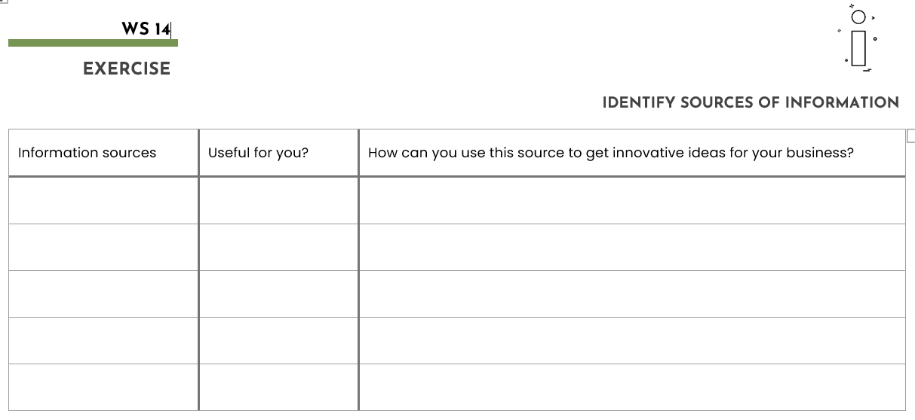
WS
14
EXERCISE :
Identifying Sources of Information
Notes:
Depending on target groups/point in time: Add AI

Slide 11
Process of Opportunity Identification
own / others
problems
needs
EVALUATION
MARKET
CREATIVITY
BUSINESS IDEA
RESOURCES
ACTION!
skills and knowledge
creativity
financial
social

Slide 12

WHAT YOU NEED TO DO Identify Market Needs and Problems
Self-Starting
Think of three ways to identify needs and problems – they are opportunities!
Look for weaknesses in competitors.
Think of new features for existing products.
The Israelites said to them, “If only we had died by the Lord’s hand in Egypt! There we sat around pots of meat and ate all the food we wanted, but you have brought us into this desert to starve this entire community to death”.
Exodus 16: 3
Notes:
Too long for action principles;
„think of 3 ways how to…“
„Changes are opportunities, problems are opportunities

Slide 13

WHAT YOU NEED TO DO Identify Market Needs and Problems
Future-Oriented
Think of at least three ways your business can benefit from current changes that will affect the market in future.
Think of at least three ways your business can turn a problem or need into an opportunity.
Overcoming Barriers
Barriers can be an opportunity for development
Notes:
Same as previous slide: Too long for action principles.
Replace last action principle: „Obstacles can be opportunity for development“

Slide 14








PEOPLE HAVE NEEDS
To identify new business opportunities look for needs people have by identifying:
What’s currently available is:
Too expensive - Could I offer something cheaper?
Not easy to use - Could I offer a more user-friendly version?
The quality is very poor - Could I offer a better made product?
Notes:
Improve English on this slide:
What is to expensive can be offered cheaper.
What is difficult to use, ….
Etc.
What could your customer need as a next step? Can you also offer this?
Give example on smart phone (service to put in the sim card etc.)
+ add examples in trainer manual

Slide 15
EXERCISE: Problems are Opportunities
WS
15
Instruction:
Work in groups of four (04).
Think about your community in Kenya, and identify the problems of its population. Select the problems that have potential solutions (e.g. "People don't have easy access to markets to sell their produce). What can I do to solve this problem?). Also think about the problems that may arise in the near future!
Choose a problem and find at least ten potential solutions.
How many of these solutions are entrepreneurial ideas?
?
Notes:
Change « commune » to « community / village / area»

